Slide 1
Twitter Sentiment Analysis
Yuanyuan Ge, John Huang,
Andrew Jing, Jason Yao, Cheng Zhong

Slide 2


Company Background
Who Are We: an AI startup Consulting Firm
Goal: Develop a POC for our product
What is POC (Proof of Concept)?
It is a method enabling end users to test a product or application in a virtual cloud environment
Core Method: Sentiment Analysis
Main Platform: Twitter
Notes:
For example, apple just releases its magic keyboard. They want the feedbacks about their keyboards. In addition to the traditional online surveys

Slide 3

Potential Clients
Enormous number of tweets that made it hard to keep track
No method to receive and categorize customer feedback about their product
Want to know the customer reflection towards their recent campaign
…...

Slide 4
Profitability
Create multiple demos from different fields to exhibit our work
Actively contact small to medium companies - start up mobile games
Charge based on the data volume, keyword numbers and
research depth

Slide 5
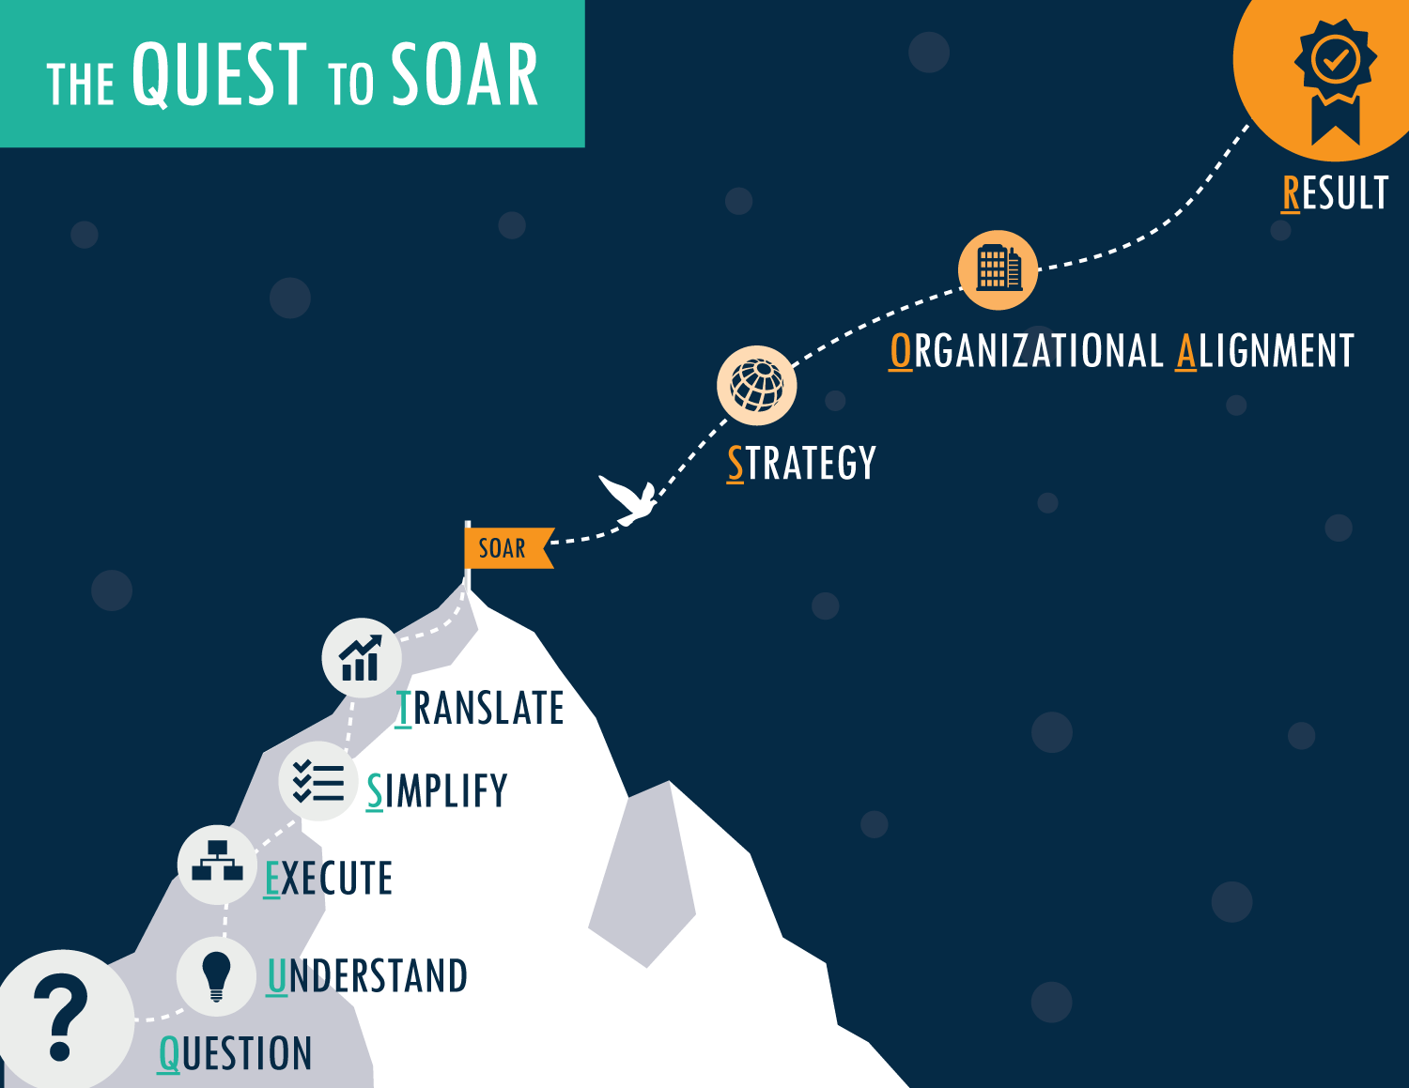
Strength
Carefully designed, custom-built market research solutions
Comprehensive researched consulting services
Industry knowledge in Online Gaming & Mobile Gaming

Slide 6

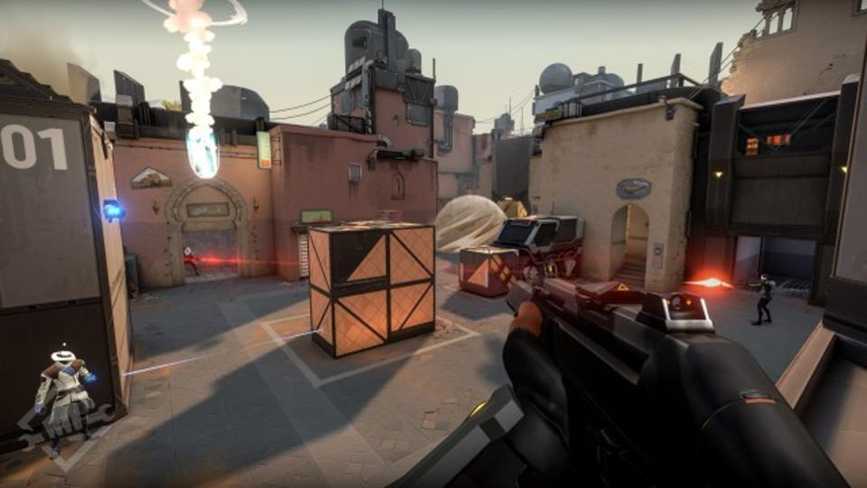

Demo-Valorant
Valorant is an upcoming first-person shooter online game
Developed and published by
Riot Games.
Started it’s closed beta on April 7th.
During this development phase, receiving user’s feedback is crucial
Notes:
Valorant is an upcoming first person shooeter online game. This game is

Slide 7
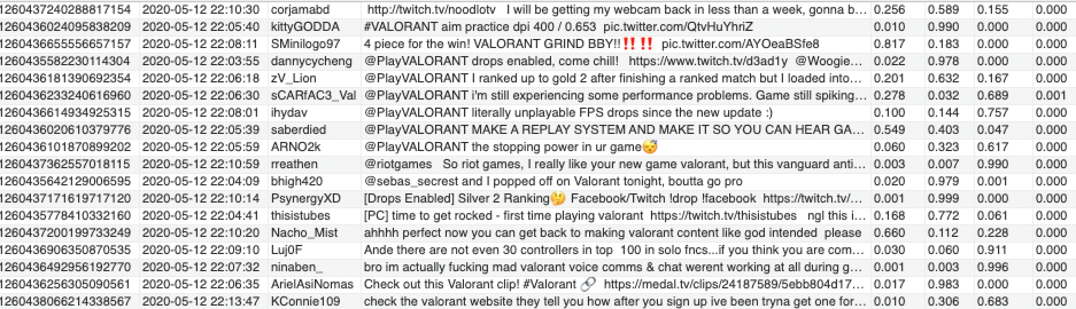
1.Data Preparation
Web-Scraping using twint package, scrape tweets with specified date range
Columns:
Tweet ID
Date: date and hour of the tweet
Username: the author of the tweet
Tweet content: text of the tweet

Slide 8



2.Sentiment Analysis on the Cloud
Connect to AWS Comprehend (NLP service on the cloud) using Boto3
Classify Sentiment of Tweets into 4 categories with a score ranging from 0 to 1:
Positive
Neutral
Negative
Mixed
Notes:
Cloud NLP Model

Slide 9
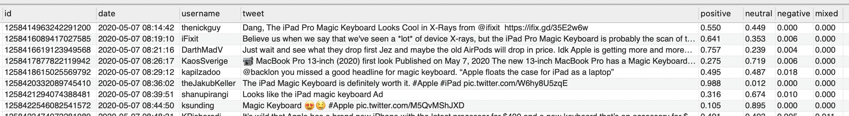
3. Structured Database
Based on customer needs
specific date range
data volume
customized, structured database
Columns
Tweets Info (Tweet ID, Date, Username, Tweet content)
Sentiment Score (Positive, Neutral, Negative, Mixed)
Notes:
Database

Slide 10
Opportunity for Investors
Monitor consumer attitude towards the product
Before launching - Evaluate Potential Market
After launching - Adjust marketing strategy, etc
Track Campaign Effectiveness
Compare Sentiment Score before/after campaign
Track the changement throughout the campaign time period
Network analysis based on tweet author
How social network is influencing the product word-of-mouth
How to leverage the social network to improve brand image
Notes:
Monitor:
对产品的态度
Track campaign 的作用
Discover:

Slide 11
Q&A
Notes:
Monitor:
对产品的态度
Track campaign 的作用
Discover:

